Slide 1
노조간부를 위한 국제기준
IndustriALL/FNV/LO-TCO
Asia MNCs & Social Dialogue
Yoon Hyowon
industriallyoon@gmail.com

Slide 2
사회적 대화란?
ILO “노동자, 사용자, 정부 간의 정보 공유를 포함하여 공통의 이해관계와 관련된 모든 형태의 교섭과 협의”

Slide 3
사회적 대화의 결과물들
단체교섭과 단체협약
노동자의 경영참가 (정보공유 및 협의)
노동자의 정부 정책 참가
건강하고 민주적인 노사관계
사회적 대화를 위한 의제로서 국제기준

Slide 4
노조간부가 알아야 할 국제기준
ILO Core Labour Standards
OECD Guidelines for MNCs
UN Global Compact
Global Agreement with MNCs
ISO 26000

Slide 5
ILO 핵심노동기준

Slide 6
ILO란?
국제노동기구 International Labor Organization
UN 산하 노동문제 전문기관
1919년 설립
대등한 사회적 파트너로서 3자주의 구조
노동자, 사용자, 정부
185개 회원국
매년 6월 ILO 세계총회 International Conference 개최

Slide 7
ILO가 하는 일
노동기본권을 정하는 국제노동법을 협약과 권고의 형식으로 만드는 역할
Conventions: legally binding international treaties ratified by member countries
Recommendations: non-binding guidelines
189개 협약과 201개 권고
www.ilo.org

Slide 8
ILO협약
ILO협약과 권고는 국제노동법 혹은 국제노동기준이다.
24개 영역: 결사의 자유, 단체교섭, 강제노동, 아동노동, 동등대우, 3자 협의, 노동행정, 노동감독, 고용정책, 일자리 창출, 직업훈련, 고용안정, 사회복지, 임금, 노동시간, 건강과 안전, 파트타임 등

Slide 9
국가별 비준 현황 (as of 2013 April)
India: 43 (4)
Indonesia: 18 (8)
Malaysia: 16 (6)
Thailand: 15 (5)
Vietnam: 19 (5)
Cambodia 13 (8)
Korea: 28 (4)
China: 25 (4)
Japan: 48 (6)
Saudi Arabia: 15 (5)
Iraq: 66 (7)
Iran: 13 (5)
Lebanon: 51 (7)
Myanmar: 21 (2)
Philippines: 37 (8)
Singapore: 27 (6)
Sri Lanka: 40 (8)
Brazil: 96 (7)
Canada: 34 (6)
Chile: 61 (8)
Denmark: 72 (8)
France: 124 (8)
Germany: 83 (8)
Italy: 111 (8)
Jordan: 24 (7)
Mexico: 78 (6)
Netherlands: 106 (8)
New Zealand: 60 (6)
Norway: 107 (8)
Russia: 69 (8)
South Africa: 23 (8)
Spain: 133 (8)
Sweden: 93 (8)
Switzerland: 58 (8) Turkey: 56 (8)
UK: 86 (8)
USA: 14 (2)

Slide 10
ILO핵심노동기준
가장 기본적이고 중요한 협약(국제노동법)
국제적으로 인정받고 승인된 보편적 기준
국가의 비준은 중요하지 않아
모든 나라와 모든 공장에 적용
4개 영역 8개 협약

Slide 11
ILO 기본협약 Fundamental Conventions
Freedom of Association and Protection of the Right to Organize Convention, 1948 (No. 87)
Right to Organize and Collective Bargaining Convention, 1949 (No. 98)
Forced Labor Convention, 1930 (No. 29)
Abolition of Forced Labor Convention, 1957 (No. 105)
Minimum Age Convention, 1973 (No. 138)
Worst Forms of Child Labor Convention, 1999 (No. 182)
Equal Pay Convention, 1951 (No. 100)
Discrimination (Employment and Occupation) Convention, 1958 (No. 111)

Slide 12
ILO 핵심노동기준 Core Labor Standards
4 개 영역
freedom of association & right to collective bargaining (C87, C98)
No forced labor(C29, C105)
No child labor(C138, 182)
No discrimination (C100, C111)

Slide 13
결사의 자유 Freedom of Association
Workers have the freedom and right to organize their own organizations or join trade unions to represent 노동자 이익 their interests and defend 노동자 권리 their rights.
Employers or government can not interfere with union organizing or union activities.

Slide 14
결사의 자유 Freedom of Association
Workers have the freedom and right to Umbrella workers organization 상급단체 like regional/national unions and industrial/national federation can directly engage in supporting workers and organizing unions.

Slide 15
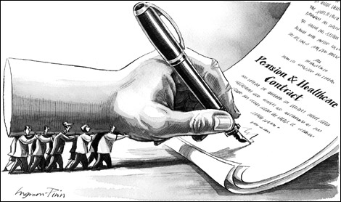
단체교섭권The Right to Collective Bargaining
Collective bargaining is a negotiation between management and union to jointly decide 공동 결정 wage, working conditions, social or economical environment which influence the livelihood of workers or their families 노동자와 그 가족의 생계.

Slide 16
단체교섭권 The Right to Collective Bargaining
The final result of collective bargaining is to make a collective agreement (CBA) 단체협약.
The CBA can be made at local, regional, industrial and national levels.

Slide 17
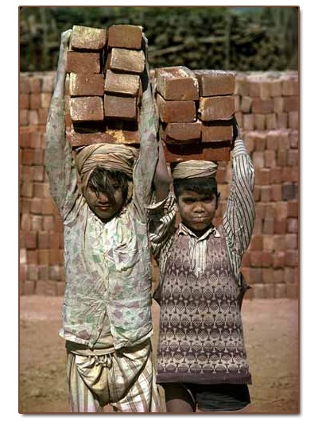
아동노동 금지 No Child Labor
Minor work should not be allowed to those under 13-years old.
Normal work should not be allowed to those under 15-years old.
Dangerous work should not be allowed to those under 18-years old.

Slide 18
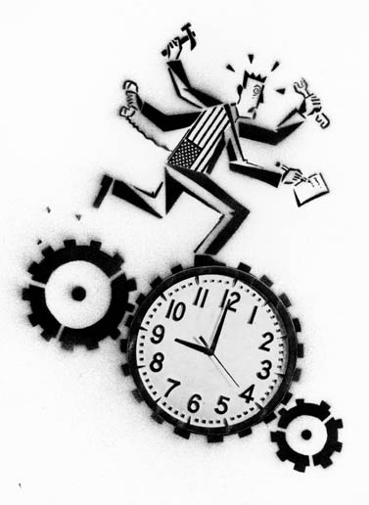
강제노동 금지Forced Labor
Doing work by threat and enforcement, without my agreement or approval
Overtime 연장근로 without dialogue with workers or unions

Slide 19
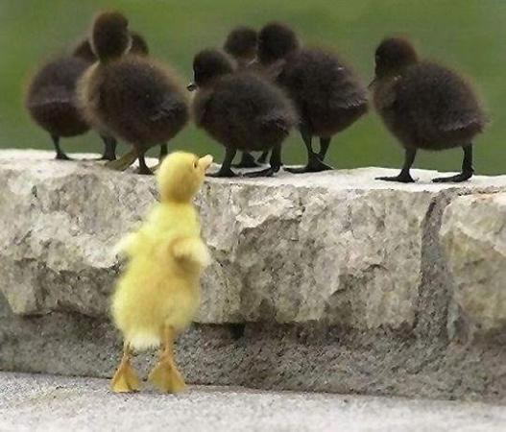
차별금지 No Discrimination
Equal pay for equal work, equal treatment for equal work 동일노동 동일임금
Discrimination between men and women
Discrimination between regular and non-regular workers
What kind of discrimination do we experience in our workplace?

Slide 20
Ratification by Country
Country | Conv. 87 | Conv. 98 | Conv. 29 | Conv. 105 | Conv. 138 | Conv. 182 | Conv. 100 | Conv. 111
India | No | No | 1954 | 2000 | No | No | 1958 | 1960
Indonesia | 1998 | 1957 | 1950 | 1999 | 1958 | 1999 | 1999 | 2000
Malaysia | No | 1961 | 1957 | No | 1997 | No | 1997 | 2000
Thailand | No | No | 1969 | 1969 | 2004 | 2001 | 1999 | No
Vietnam | No | No | 2007 | No | 2003 | 2000 | 1997 | 1997
Korea | No | No | No | No | 1999 | 2001 | 1997 | 1998

Slide 21
OECD 다국적기업 가이드라인Guidelines for Multinational Enterprises

Slide 22
OECD란?
경제협력개발기구Organization for Economic Cooperation & Development
“시장경제” 구축을 위한 부자나라들의 모임
1948년 설립
34개 회원국
Australia, Austria, Belgium, Canada, Chile, Czech Republic, Denmark, Estonia, Finland, France, Germany, Greece, Hungary, Iceland, Ireland, Israel, Italy, Japan, Korea, Luxembourg, Mexico, Netherlands, New Zealand, Norway, Poland, Portugal, Slovak Republic, Slovenia, Spain, Sweden, Switzerland, Turkey, United Kingdom, US
www.oecd.org

Slide 23
OECD Guidelines for MNCs
International standard for “good corporate conduct”
1976년 제정, 2000년과 2011년 대폭 개정.
“다국적기업은 경제적, 환경적, 사회적 진보에 기여해야 한다.”
Not legally binding, but voluntary guidelines (recommendation)
국가연락사무소 National Contact Point (NCP)
suppliers and subcontractors to apply the Guidelines

Slide 24
OECD Guidelines for MNCs
다국적기업
1개 이상 나라에서 영업활동을 하는 기업
11개 장
1. Concept and principles, 2. General Policies, 3. Information Disclosure, 4. Human Rights, 5. Employment and Industrial Relations, 6. Environment, 7. Combating Bribery, 8. Consumer Interests, 9. Science & Technology, 10. Competition, 11. Taxation

Slide 25
OECD Guidelines for MNCs
3장. 정보공개
Timely and accurate information is disclosed on activities, structure, financial situation, performance, ownership and governance , shareholders and voting rights, etc.
다국적기업에 대한 분명하고 완전한 정보
Financial and operating results of the company
Information on board members (qualification and selection process) and key executives, and their remuneration (pay)
Information and issues on workers and stakeholders
Information on subcontractors and suppliers
Governance structure and policies
Information on internal audit (financial statements)

Slide 26
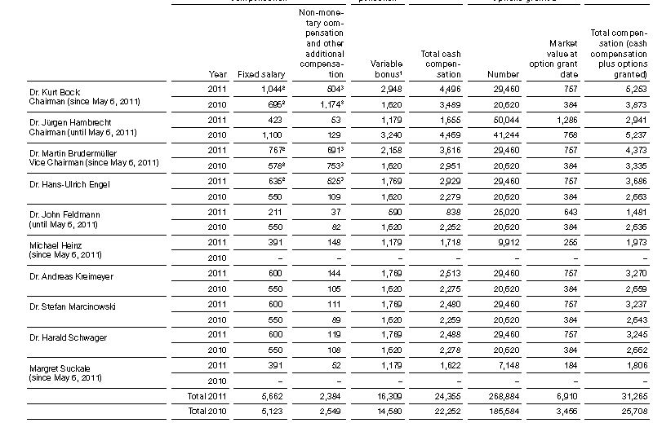
2011 BASF key managers salary

Slide 27
Lafarge 2009 Annual Report

Slide 28
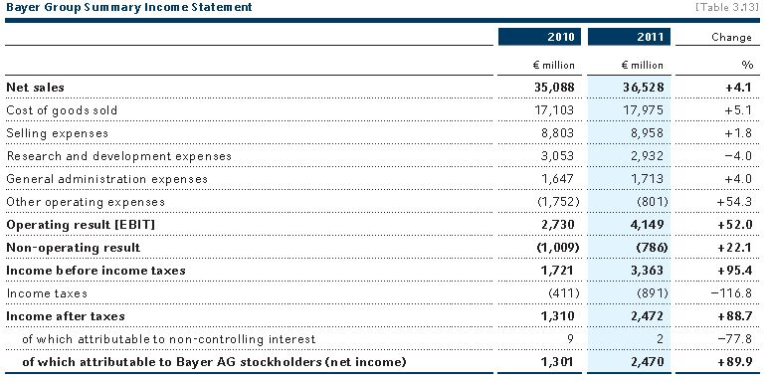
Bayer 2011 Report

Slide 29
OECD Guidelines for MNCs
4장. 인권
MNC must respect human rights
MNC must prevent or mitigate adverse human rights impacts that are directly linked to its business operations, products or services.
인권관련 국제기준
The International Bill of Human Rights, consisting of the Universal Declaration of Human Rights
The International Covenant on Civil and Political Rights
The International Covenant on Economic, Social and Cultural Rights
The ILO Declaration on Fundamental Principles and Rights at Work
What is the key part of human rights?

Slide 30
OECD Guidelines for MNCs
5장. 고용 및 노사관계
노동조합 결성 혹은 가입 관련 노동자 권리의 존중
건설적인 집단협상 및 단체교섭을 위한 노동자 권리의 존중
아동노동의 폐지
강제노동의 폐지
고용과 직업에서 기회와 대우의 평등

Slide 31
OECD Guidelines for MNCs
5장. 고용 및 노사관계
Provide facilities to workers’ representatives for effective collective agreements
Provide information needed for meaningful negotiations
Promote consultation and cooperation on matters of mutual concern
Provide the best possible wages, benefits and conditions of work, which is adequate to satisfy the basic needs of the workers and their families
Take adequate steps to ensure health & safety at work
Provide job training to improve skill levels
Provide reasonable notice in case of change of employment effects such as collective lay-offs or dismissals, and meaningful cooperation to mitigate the effects of such decisions
Do not threaten to transfer the whole or part of plant to other country in order to unfairly influence negotiations and hinder the exercise of a right to organize
Allow workers representatives to consult with management representatives who are authorized to take decisions in collective bargaining and labor relations

Slide 32
OECD Guidelines for MNCs
가이드라인 참여 정부의 국가별 연락사무소 설치 National Contact Point (NCP).
가이드라인 위반 관련 누구나 NCP에 문제나 사건을 제기할 수 있다 raise the issue or case.
NCP 는 OECD에 문제를 보고해야 한다.

Slide 33
UN Global Compact

Slide 34
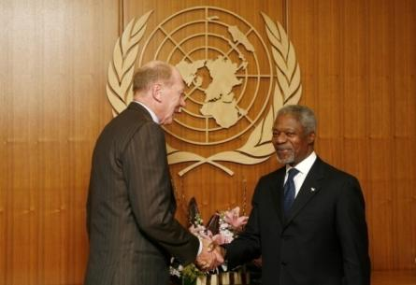
UN Global Compact
Kofi Annan 1999년 World Economic Forum에서 제안하여 2000년 7월 공식 출범.
유엔이 주도하는 기업의 사회적 책임 Corporate Social Responsibility (CSR) 관련 국제기준
145개국 1만여 참가 조직, 7천여 기업 참여
4개 영역 10개 원칙
www.unglobalcompact.org

Slide 35
UN Global Compact
인권 Human Rights
MNC support human rights
MNC do not abuse human right
노동기준 Labor Standards
MNC respect the freedom of association and the right to collective bargaining
Elimination of forced labor
Abolition of child labor
Elimination of discrimination at work
환경 Environment
MNC support precautionary approach to environment
Promote greater environmental responsibility
Develop environmentally friendly technology
반부패 Anti-Corruption
MNC should work against all forms of corruption

Slide 36
Freedom of Association & Collective Bargaining
Ensure that all workers are able to form and join a trade union of their choice without fear of intimidation or reprisal, in accordance with national law.
Put in place non-discriminatory policies and procedures with respect to trade union organization, union membership and activity in such areas as applications for employment and decisions on advancement, dismissal or transfer.
Do not interfere with the activities of worker representatives while they carry out their functions in ways that are not disruptive to regular company operations.
Allow the collection of union dues on company premises, posting of trade union notices, distribution of union documents, and provision of office space.
Provide workers’ representatives with appropriate facilities to assist in the development of effective collective agreement.

Slide 37
Freedom of Association & Collective Bargaining
Recognize trade union for the purpose of collective bargaining.
Use collective bargaining as a constructive forum for addressing working conditions and terms of employment and relations between employers and workers.
Address any problem-solving or other needs of interest to workers and management, including restructuring and training, redundancy procedures, safety and health issues, grievance and dispute settlement procedures, disciplinary rules, and family and community welfare.
Provide information needed for meaningful bargaining.
Balance dealings with the most representative trade union to ensure the viability of smaller organizations to continue to represent their members
Inform the local community, media and public authorities of your company's endorsement of the UN Global Compact and its intention to respect its provisions, including those on fundamental workers' rights.

Slide 38
No Force Labour
Situations of forced labour are generally characterized by a lack of consent to work.
Exploitative practices such as forced overtime
Physical or psychological (including sexual) violence as a means of keeping someone in forced labour (as a threat against worker, family, or close associates)
Deception or false promises about terms and types of work
Slavery, Bonded labour or debt bondage, Physical abduction or kidnapping, Sale of a person into the ownership of another, Physical confinement in the work location (in prison or in private detention), The work or service of prisoners, Work required to punish opinion or expression of views ideologically opposed to the established political, social or economic system, The lodging of deposits (financial or personal documents) for employment, Full or partial restrictions on freedom of movement, Withholding and non-payment of wages (linked to manipulated debt payments, exploitation, and other forms of extortion), Deprivation of food, shelter or other necessities

Slide 39
No Child Labour
the term "child" covers all girls and boys under 18 years of age.
Developed countries
Light Work 13 Years
Regular Work 15 Years
Hazardous Work 18
Developing countries
Light Work 12 Years
Regular Work 14 Years
Years Hazardous Work 18 Years
Exercise influence on subcontractors, suppliers and other business affiliates to combat child labour.

Slide 40
No Discrimination
Equal treatment for equal work
Equal treatment in terms of Recruitment, Remuneration, Hours of work and rest/ Paid holidays, Maternity protection, Security of tenure, Job assignments, Performance assessment and advancement, Training and opportunities, Job prospects, Social security, Occupational safety and health

Slide 41
www.holcim.com

Slide 42
국제기본협약 Global Framework Agreement

Slide 43
국제기본협약 Global Framework Agreement
국제기본협약은 다국적기업과 국제노조 사이에 체결하는 신사협정으로 초보적인 수준의 단체협약이라 할 수 있다.
다국적기업의 Code of Conduct의 문제점인 기업의 사회적 정책에 대한 일방적 결정 을 극복하기 위한 노조의 대응
Danone-IUF 1988년 최초 체결
21세기 들어 다국적기업과 초국적자본을 규제하기 위한 국제노조의 주요 사업으로 발전

Slide 44
IndustriALL과 국제기본협약을 체결한 다국적기업들
Aker, AngloGold, BMW, Bosch, Brunel, Daimler, EADS, EDF,Electrolux, Endesa, Enel, Eni, Evonik, Ford, Freudenberg, GDF Suez, GEA, Indesit, Inditex, Lafarge, Leoni, Lukoil, MAN, Mann + Hummel,
Mizuno, Norsk Hydro, Norske Skog, Petrobras, Prym,PSA Peugeot Citroën, Renault, Rheinmetall, Rhodia, Röchling,Saab, SCA, Siemens, SKF, Statoil, Umicore, Vallourec,Volkswagen, ZF

Slide 45
IndustriALL-Lafarge 기본협약
강제노동 철폐 Abolition of forced labor
사업장 차별금지No discrimination at workplace
아동노동 폐지 Elimination of child labor
노조 조직 및 단체교섭 권리 Right to organizing trade union and collective bargaining
생활임금 보장 Guarantee living wage
건강 안전 노동조건 개선 Improve health, safety and working conditions
직업훈련 제공 Provide Job training

Slide 46
IndustriALL- Freudenberg 기본협약
No forced labor and child labor
Equal opportunities and equal treatment on the job
Freedom of association and the respect for basic trade union rights
Right to organizing trade union and collective bargaining
No discrimination against trade union representatives
Health & safety at workplace
Flexible, efficient and customer-oriented forms of work organization

Slide 47
Norske Skog-IndustriALL 기본협약
Freedom of association & collective bargaining
No discrimination and equal opportunity
Health and safety at workplace
No forced labor
No child labor
Wages & benefits covering basic needs of the workers and their family
Employment status for workers based on permanent job
Irregular workers like temporary/part-time workers must receive the same terms conditions with comparable regular workers.

Slide 48
ISO 26000
사회적 책임을 위한 ISO

Slide 49
ISO란?
국제표준화기구 International Organization for Standardization
국제적으로 통용되는 산업기준 및 상업기준을 제정하는 국제기구 (반관 반민)
1947년 창립, 제네바에 본부
161개 회원국

Slide 50
ISO member countries
India: Bureau of Indian Standards (BIS) www.bis.org.in
Indonesia: Badan Standardisasi Nasional (BSN) www.bsn.go.id
Malaysia: Department of Standards Malaysia (DSM) www.standardsmalaysia.gov.my
Thailand: Thai Industrial Standards Institute (TISI) www.tisi.go.th/
Vietnam: Directorate for Standards, Metrology and Quality (STAMEQ) www.tcvn.gov.vn
Korea: Korean Agency for Technology and Standards (KATS) www.kats.go.kr

Slide 51
ISO 26000
ISO 9000: standard for Quality Management System 품질 관리
ISO 14000: standard for Environmental Management 환경 관리
ISO 26000: “ISO SR”.
ISO 26000는 기업 및 기타 단체들을 위한 사회적 책임을 정한 ISO 기준
2010년 최종 확정
인증서의 의미보다는 사회적 책임에 대한 공통된 이해를 제공한다는 의미.

Slide 52
ISO 26000
7 개 영역
7개 원리
Organizational governance
Human rights
Labour practices
Environment
Fair operating practices
Consumer issues
Community involvement and development
Accountability
Transparency
Ethical behavior
Respect for stakeholder interests
Respect for the rule of law
Respect for international norms of behavior
Respect for human rights

Slide 53
인권
ILO 핵심노동기준 Core Labour Standards
노동자대표의 편의권 Workers representatives should be given appropriate facilities that will enable them to do their work effectively and allow them to perform their without interference.
노동자대표의 정보권 Workers representatives should be provided with information required for meaningful negotiations.

Slide 54
노동 문제
Including subcontracted work and workplace under direct control
Recruitment and promotion of workers, disciplinary and grievances procedures, transfer and relocation of workers, termination of employment, training and skills development, health and safety, policy affecting conditions of work such as working time and remuneration.
Recognition of workers organizations and representation, participant of both worker and employer in collective bargaining, social dialogue and tripartite consultation on social issues related to employment

Slide 55
노조간부가 알아야 할 국제기준
ILO Core Labour Standards
OECD Guidelines for MNCs
UN Global Compact
Global Agreement with MNCs
ISO 26000

Slide 56
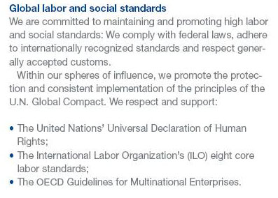

Slide 57
국제기준의 공통점
노조 결성/가입과 단체교섭 권리 Workers rights to organize and CA
아동노동 금지 No child labor,
강제노동 금지 No forced labor
차별 금지 No discrimination
노조활동 보장 Guarantee of union activity
단체교섭 및 노조활동 편의 제공 Facilities for collective bargaining & union activity
괜찮은 임금 Decent wage
좋은 노동조건과 노동시간 Good working conditions and work hours
건강과 안전 Health & safety
정보공유 Information sharing
협의권 및 노동자 경영참가 Consultation right
직업훈련 및 숙련개발 Job training / skill development

Slide 58
국제기준의 활용
국제기구들 (ILO, OECD, UN)과 정부가 직접 국제기준에 관여.
국제기준은 노동자권리, 노조활동 자유, 단체교섭, 노동조건, 건강과 안전, 정보 공개, 협의권, 직업훈련 등을 언급 .
사용자 및 정부와의 사회적 대화를 위한 의제 혹은 주제
단체교섭의 의제
단체협약의 내용
기업의 사회적 책임CSR의 출발점

Slide 59
노사관계/단체교섭/사회적 대화의 영역
Job Training
Discrimination
Equal opportunities
Contractors
Health & safety
Contract & agency workrers
Management of Change
Restructuring
Privatization
Economic policy
Human Rights
Wages
Working time
CSR
Equitable
Trade
현장/사업장Company/workplace
산업Industrial
전국National
국제International
Notes:
Aujourd’hui, la régulation n’oppose plus le national et l’européen mais suggère une complémentarité des niveaux d’intervention qui ne s’arrêtent pas à l’Europe

Slide 60
Yoon Hyowon mobile: (+82) 10 2083 4715 industriallyoon@gmail.com

